Slide 1
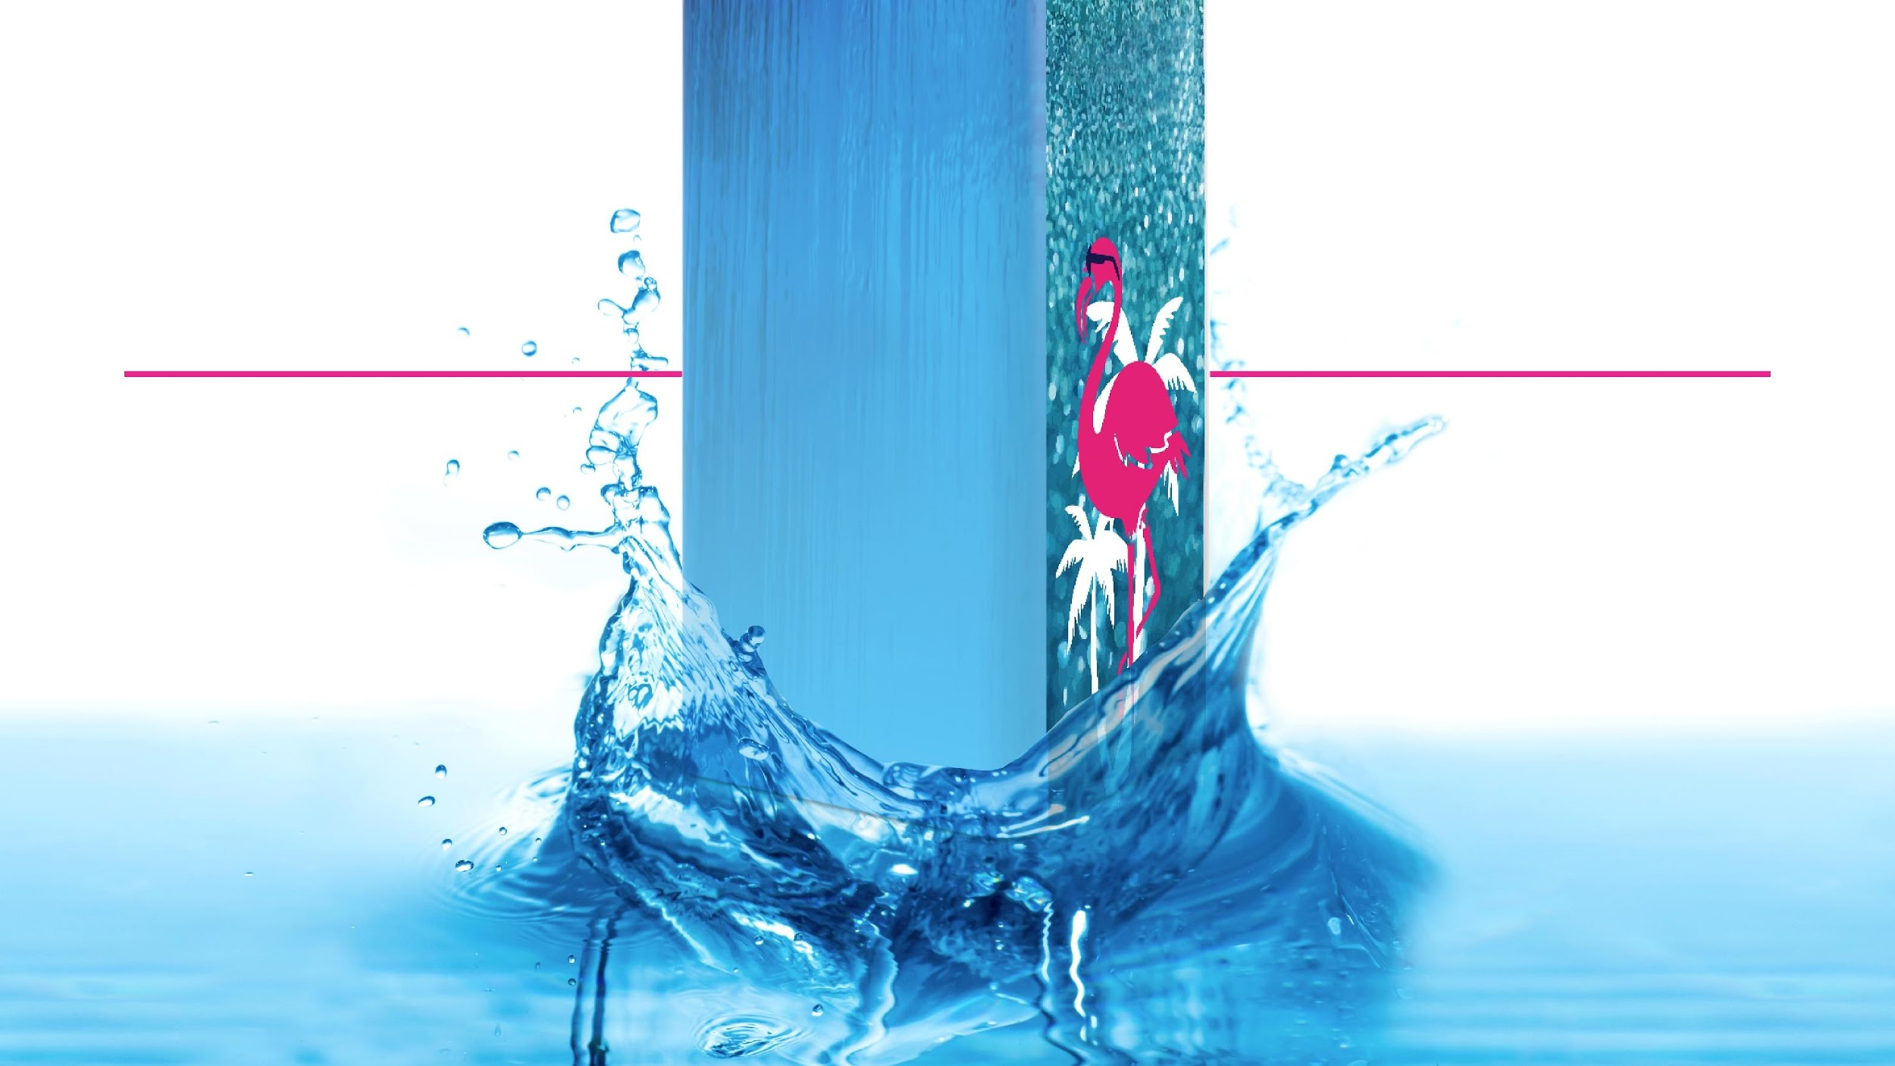
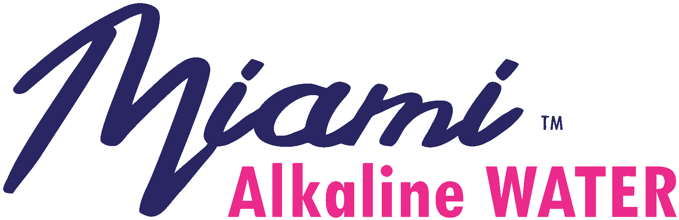

Slide 2
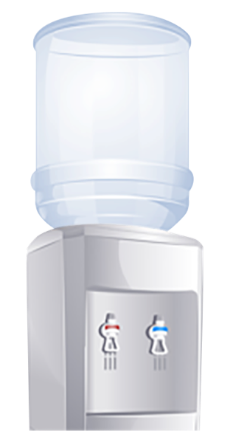
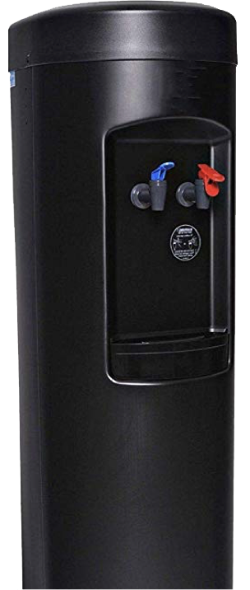
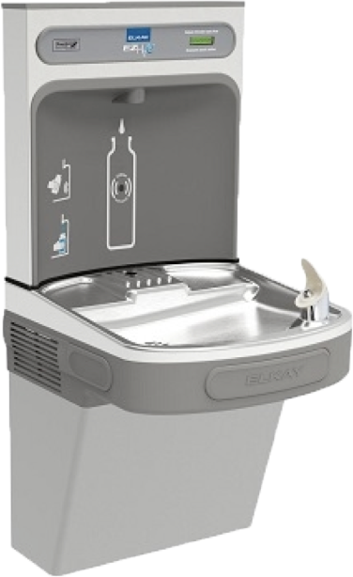

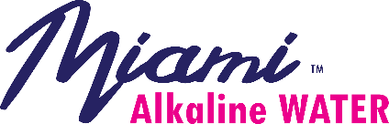
YESTERDAY’S OPTIONS FAIL US
THE ISSUES
POOR TASTE
UNSANITARY
INEFFICIENT
Risk of cross contamination
Excessive waste
Minimal water purification
High exposure to microbes
Timely installation and maintenance

Slide 3
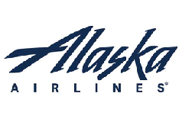


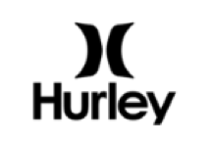

































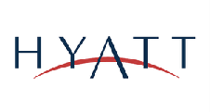
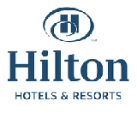
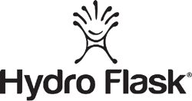



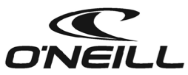















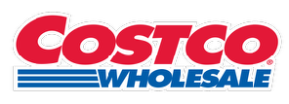

TOMORROW 'S INNOVATION IS HERE
Some of our clients that are DISRUPTING the water industry
WORK
REST
PLAY
Corporations
Health
Fitness
Schools
Hotels
Retail
Notes:
The absolute top brands in the U.S. love and use FloWater. These brands are dedicated to providing sustainable options their employees/guests/members/shoppers love. This drives positive experiences, positive reviews, and loyalty.

Slide 4
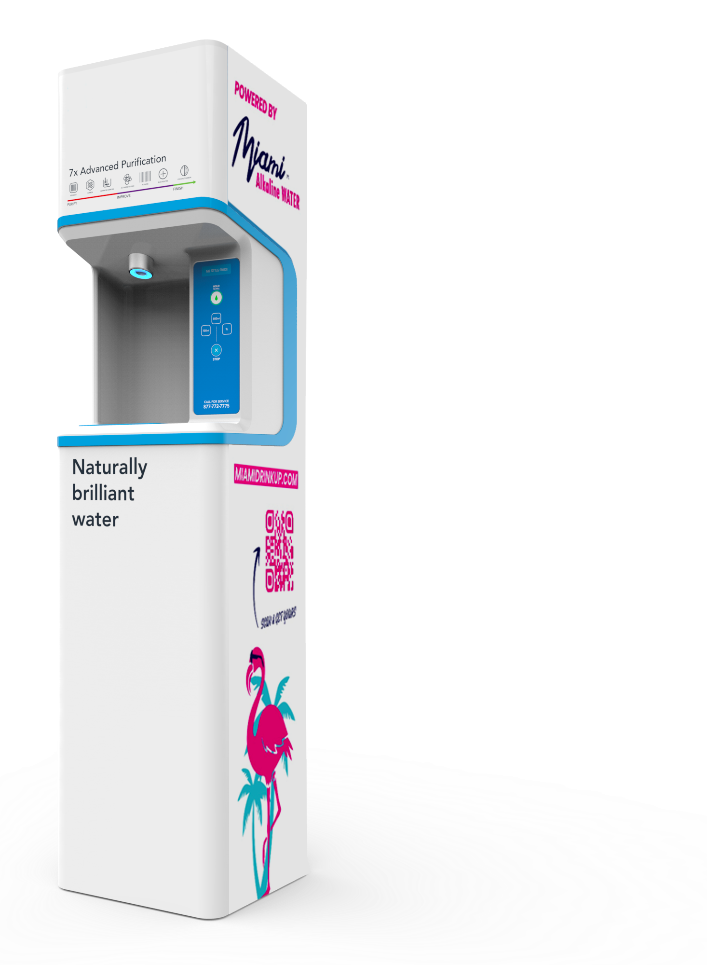
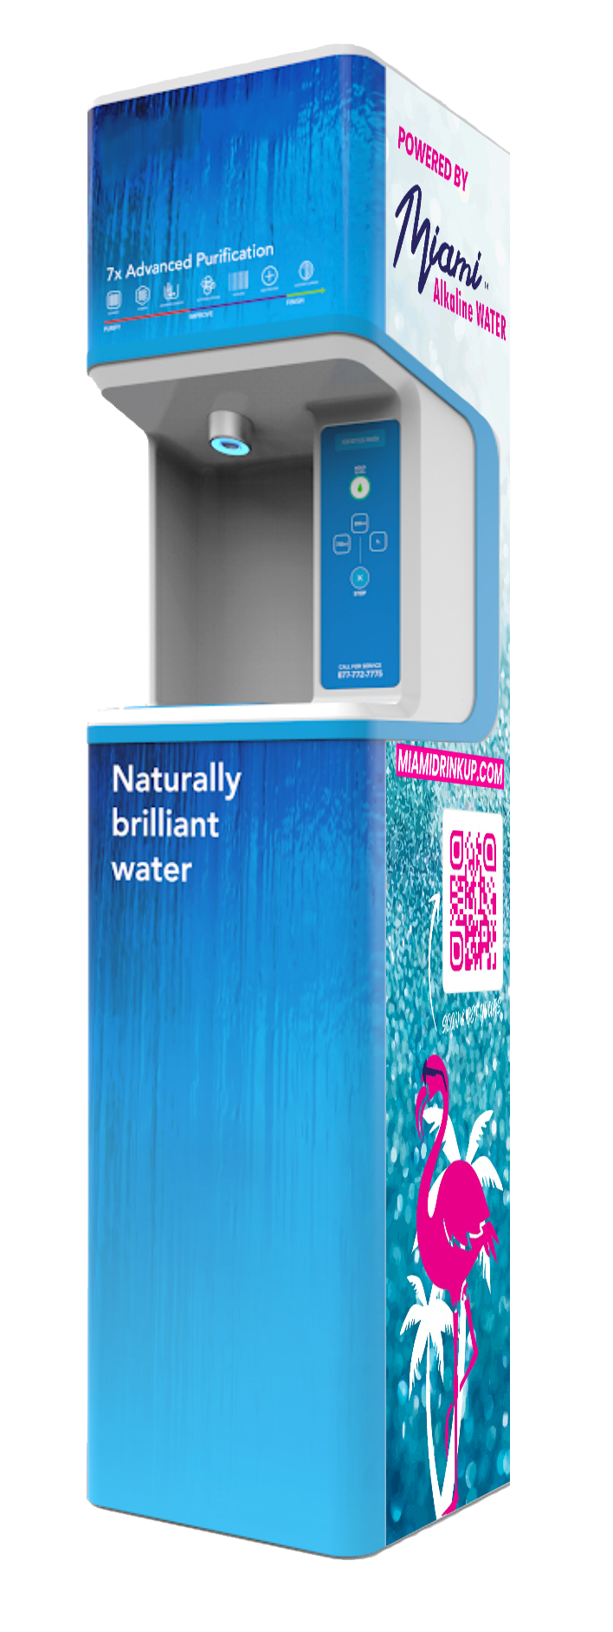






TRANSFORMING DRINKING WATER
Antioxidant Alkaline Water
(-100/-300 ORP) & 9.5PH+
Note: Natural Orange Juice approx ORP – 50
Neutralizes Free Radicals
Faster Hydration (Microcluster)
Better Focus provides a safer work environment
FORTIFIED WITH CALCIUM, MAGNESIUM, POTASSIUM AND 70+ TRACE MINERALS SUPPLIED FROM ECOSAFE CERTIFIED FOSSILIZED ABOVE SEA CORAL.
Hydration Station
Notes:
The absolute top brands in the U.S. love and use FloWater. These brands are dedicated to providing sustainable options their employees/guests/members/shoppers love. This drives positive experiences, positive reviews, and loyalty.

Slide 5
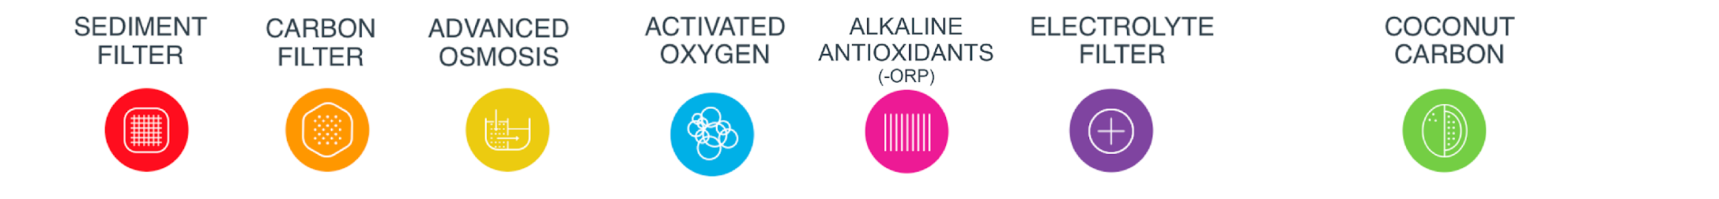

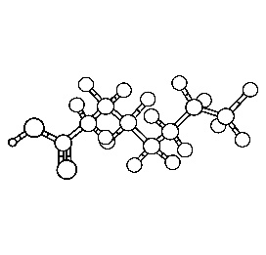

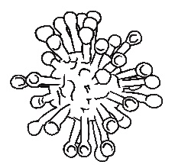
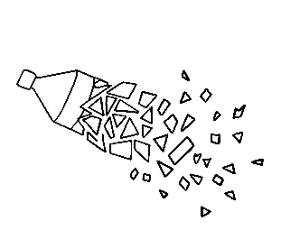
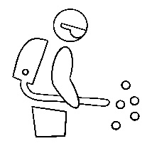

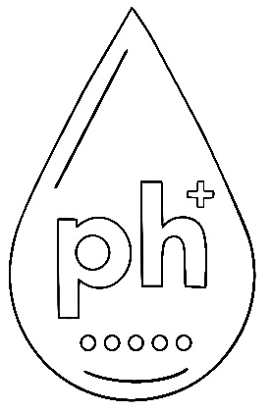




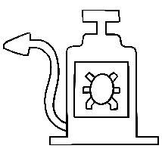

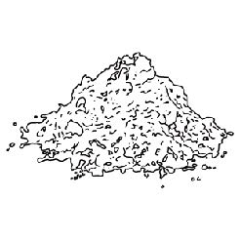
THE PROCESS THAT MAKES US UNIQUE!
1
2
3
4
5
6
7
BACTERIA
PFAS
RUST
VIRUSES
MICROPLASTICS
PESTICIDES
ELECTROLYTES
ALKALINE
ANTIOXIDANTS
HEAVY METALS
COCONUT CARBON
CHLORINE
DIRT
GLYPHOSATE
DUST
SAND
Notes:
The absolute top brands in the U.S. love and use FloWater. These brands are dedicated to providing sustainable options their employees/guests/members/shoppers love. This drives positive experiences, positive reviews, and loyalty.

Slide 6
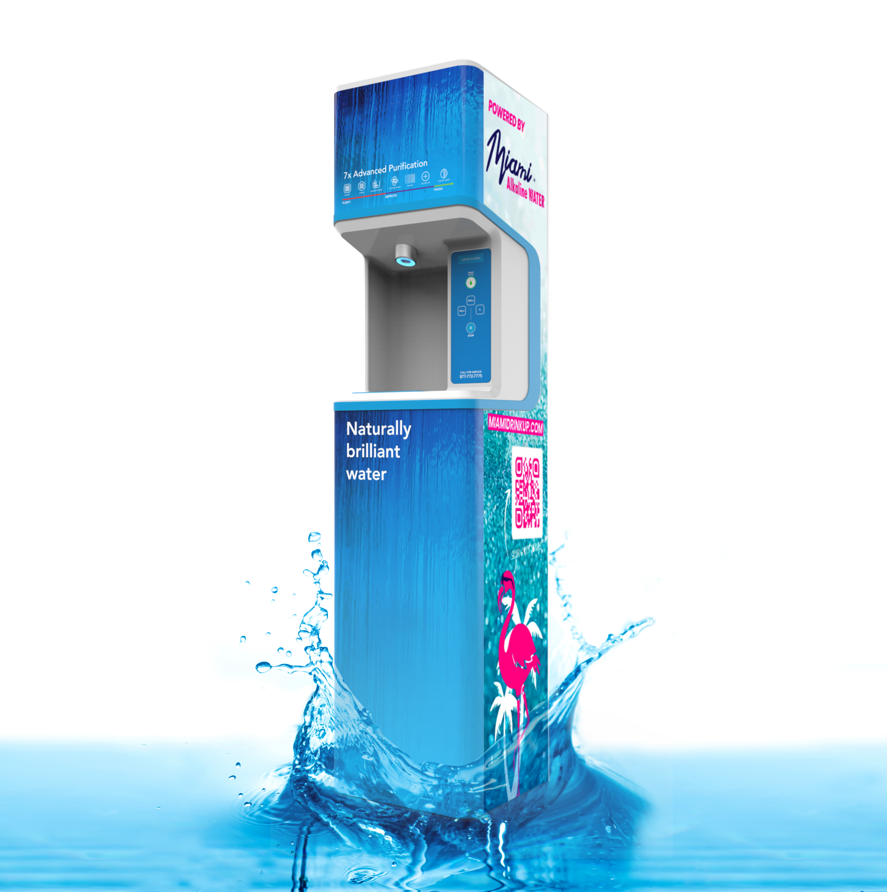

DON'T WAIT!
is looking for the first
Eligible locations
at $0 upfront Cost
Notes:
The absolute top brands in the U.S. love and use FloWater. These brands are dedicated to providing sustainable options their employees/guests/members/shoppers love. This drives positive experiences, positive reviews, and loyalty.

Slide 7
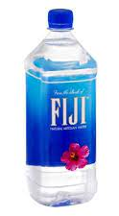
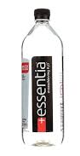
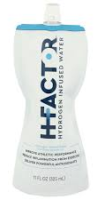
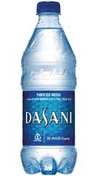
YOU WILL EXPERIENCE THE ROLLS ROYCE OF THE WATER
HERE IS WHY...
$ 1
$ 2,20
$ 3
$ 4,40
Reverse Osmosis
Artisan Water
Alkaline Water
Antioxidant Water
For a fraction of these costs, You'll provide UNLIMITED ANTIOXIDANT ALKALINE WATER,
and also IMPROVE your REVENUE !
Notes:
The absolute top brands in the U.S. love and use FloWater. These brands are dedicated to providing sustainable options their employees/guests/members/shoppers love. This drives positive experiences, positive reviews, and loyalty.

Slide 8
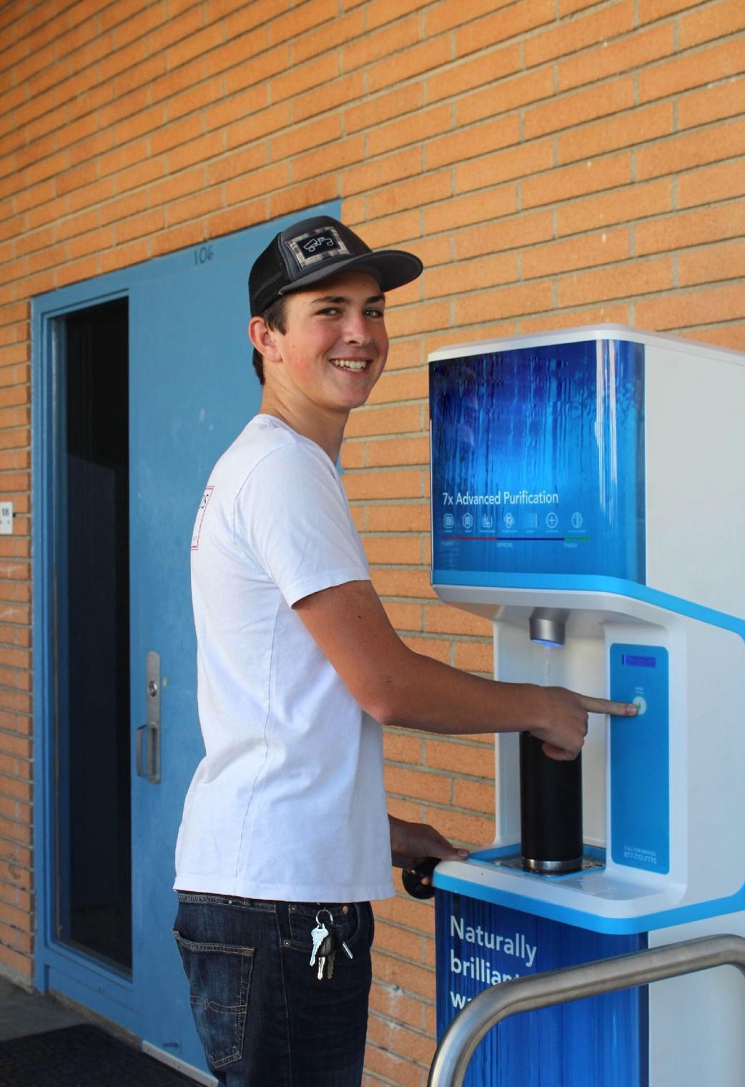



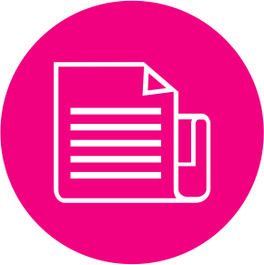

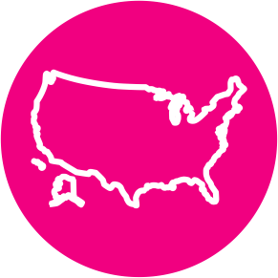
BE THE DIFFERENCE
Elevate your brand
Save money through Sustainability
Energized WATER boosts employee wellness
Convenience (NO More Inventory on hand)
Hydration Station is a revenue producing machine
Nationwide Support
Notes:
The absolute top brands in the U.S. love and use FloWater. These brands are dedicated to providing sustainable options their employees/guests/members/shoppers love. This drives positive experiences, positive reviews, and loyalty.

Slide 9
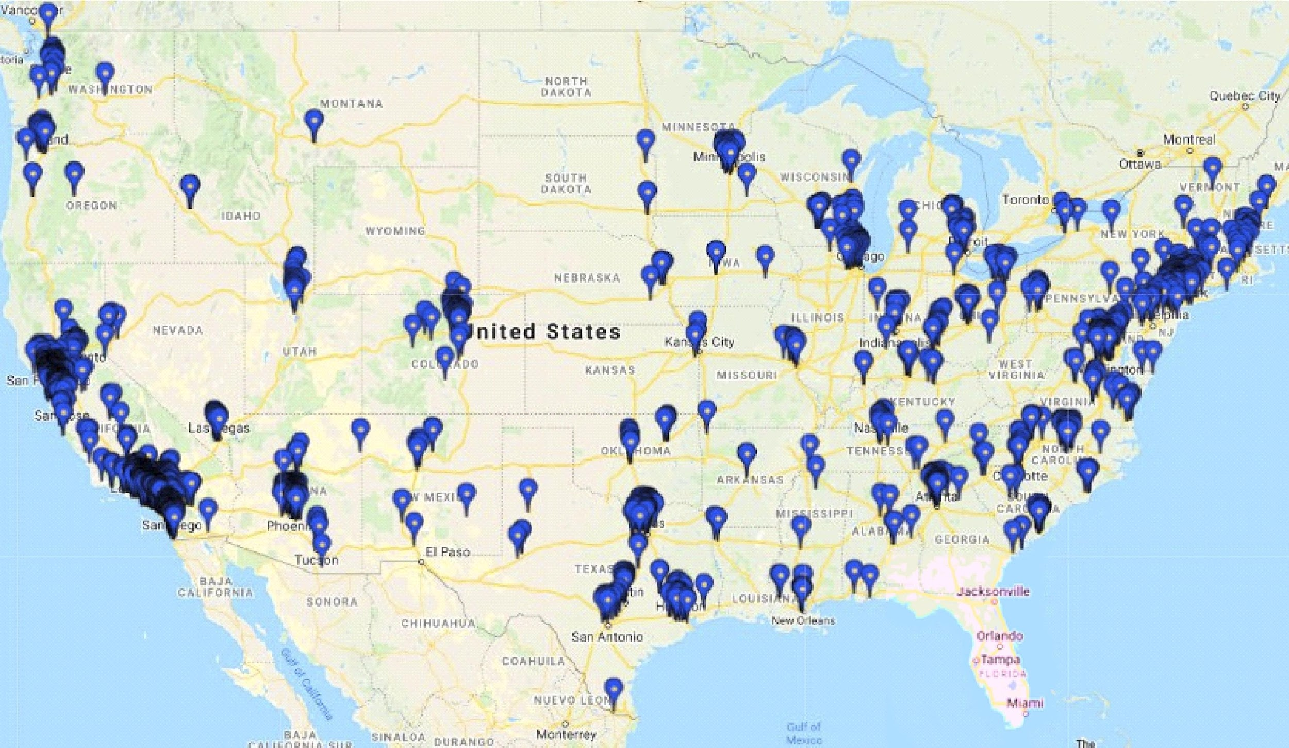
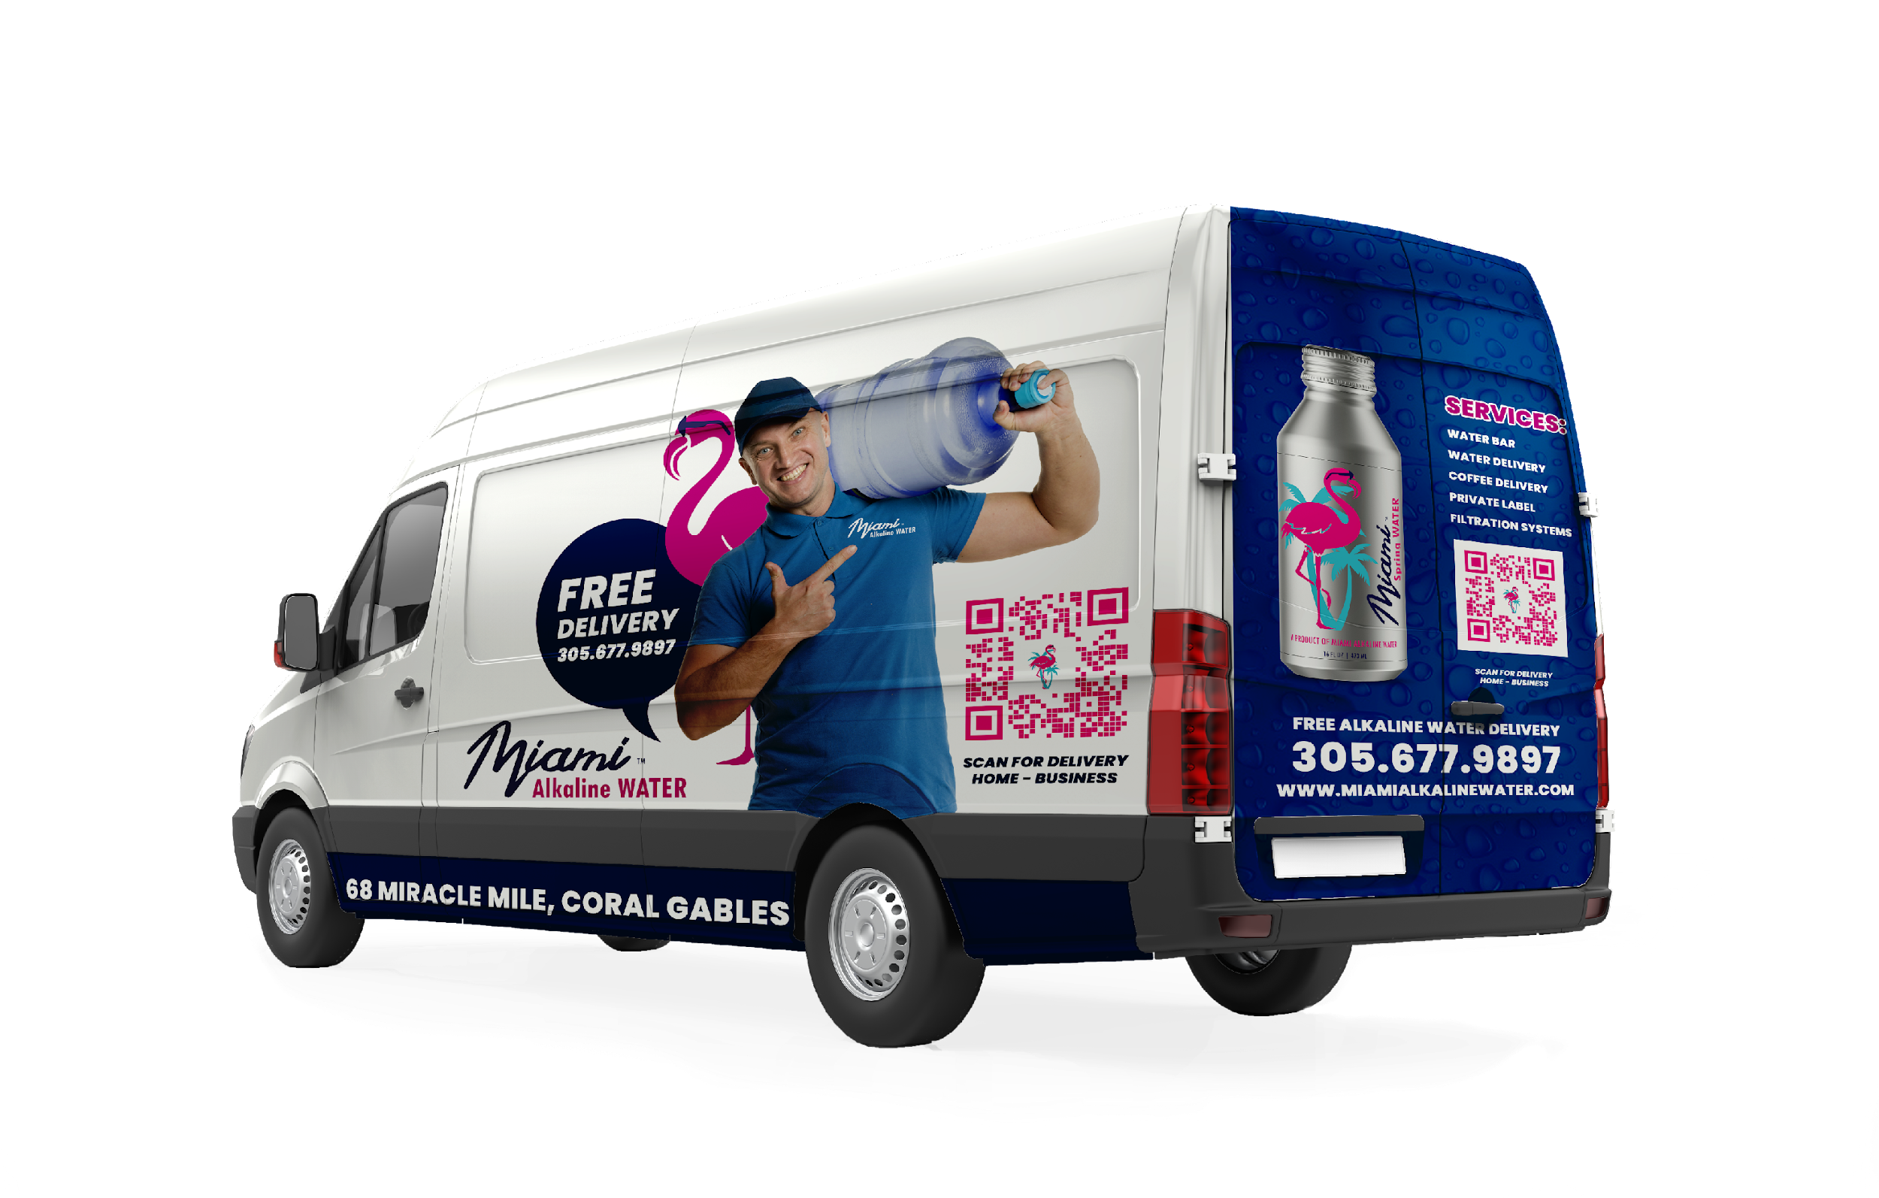
TRUSTED COAST TO COAST
200 locations will benefit from this LIMITED partnership
Notes:
The absolute top brands in the U.S. love and use FloWater. These brands are dedicated to providing sustainable options their employees/guests/members/shoppers love. This drives positive experiences, positive reviews, and loyalty.

Slide 10

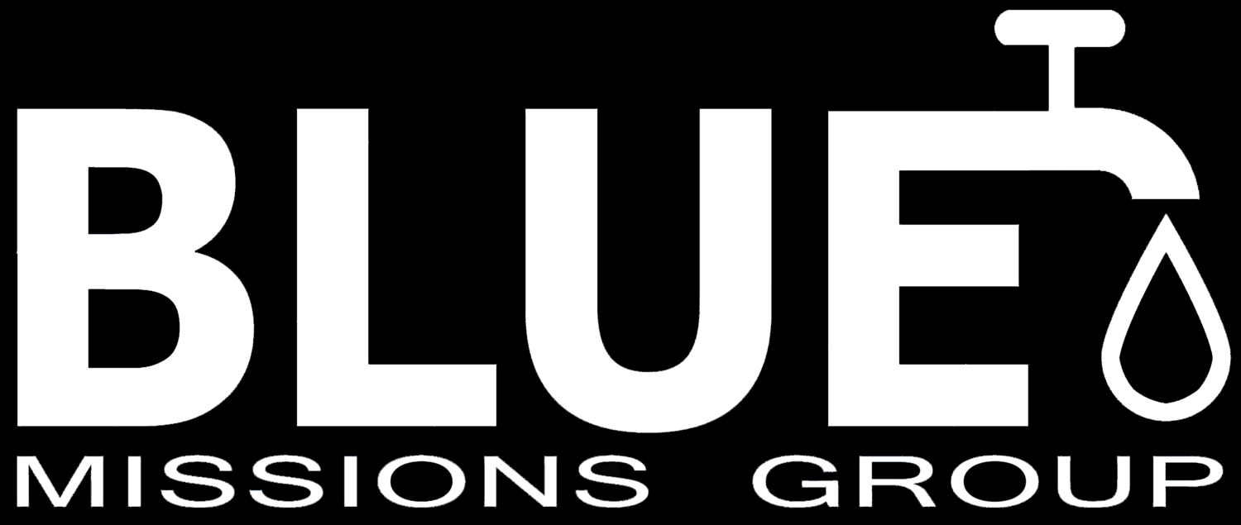
THANK YOU
FOR YOUR
CONTRIBUTION
TO OUR PLANET
Notes:
The absolute top brands in the U.S. love and use FloWater. These brands are dedicated to providing sustainable options their employees/guests/members/shoppers love. This drives positive experiences, positive reviews, and loyalty.

Slide 11
Notes:
The absolute top brands in the U.S. love and use FloWater. These brands are dedicated to providing sustainable options their employees/guests/members/shoppers love. This drives positive experiences, positive reviews, and loyalty.

